Slide 1
Auto-population using Node-RED Node Generator
Kunihiko Toumura (Hitachi)
17 September 2020

Slide 2

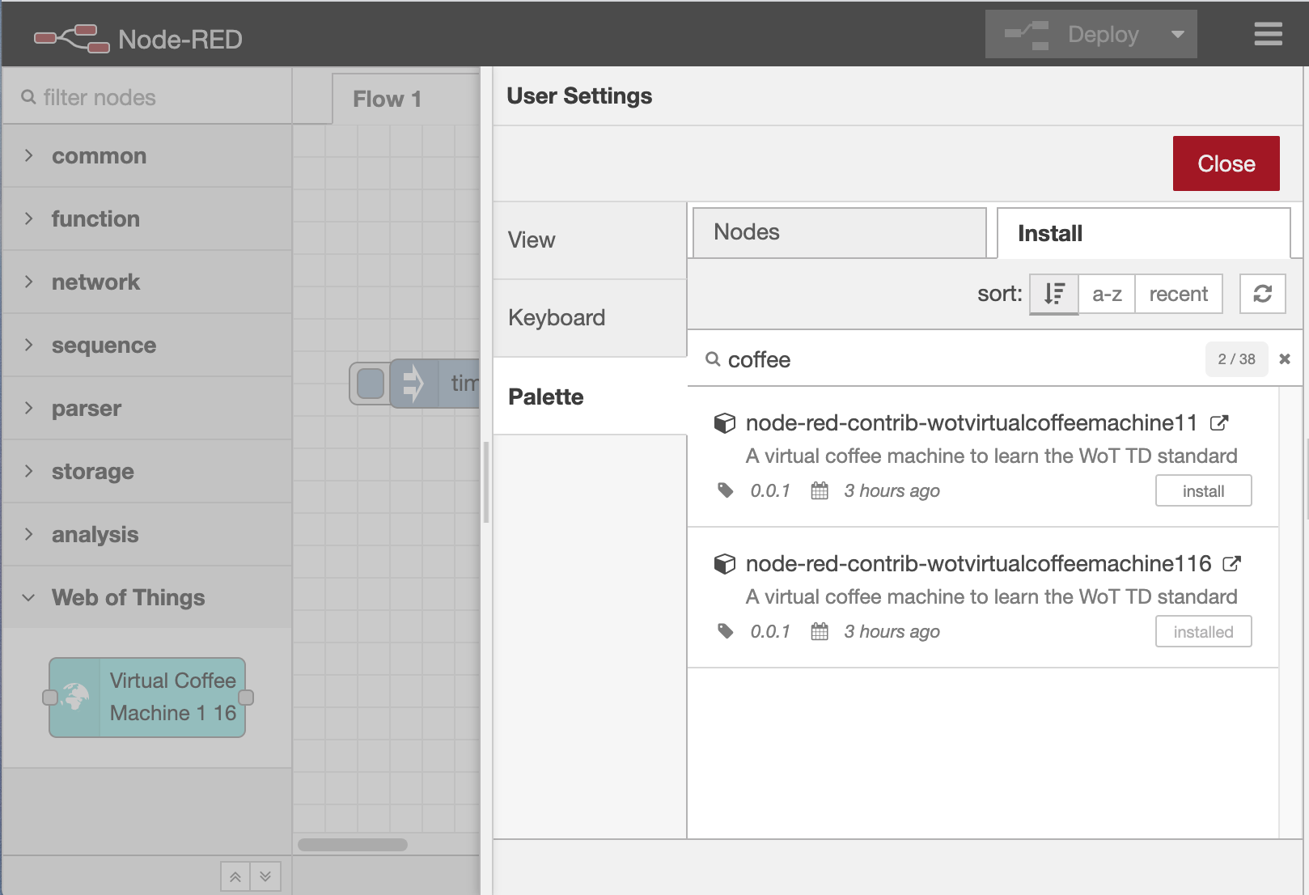
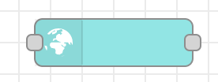
About this demo
Node-RED, the well-known low-code development tool from the OpenJS Foundation, supports the WoT Thing Description as part of the Node Generator project to simplify the development of Node-RED nodes.
In this demo, we’ll show you how to automatically populate Things in the Node-RED’s editor screen.
Things
Node-RED
Auto-population Server
Generate a catalogue
Catalogue
Server
Node
Generator
Retrieve
TDs
Generate
node
modules
Retrieve
a catalogue
and
node
modules
Installed
WoT node
Node Catalogue

Slide 3
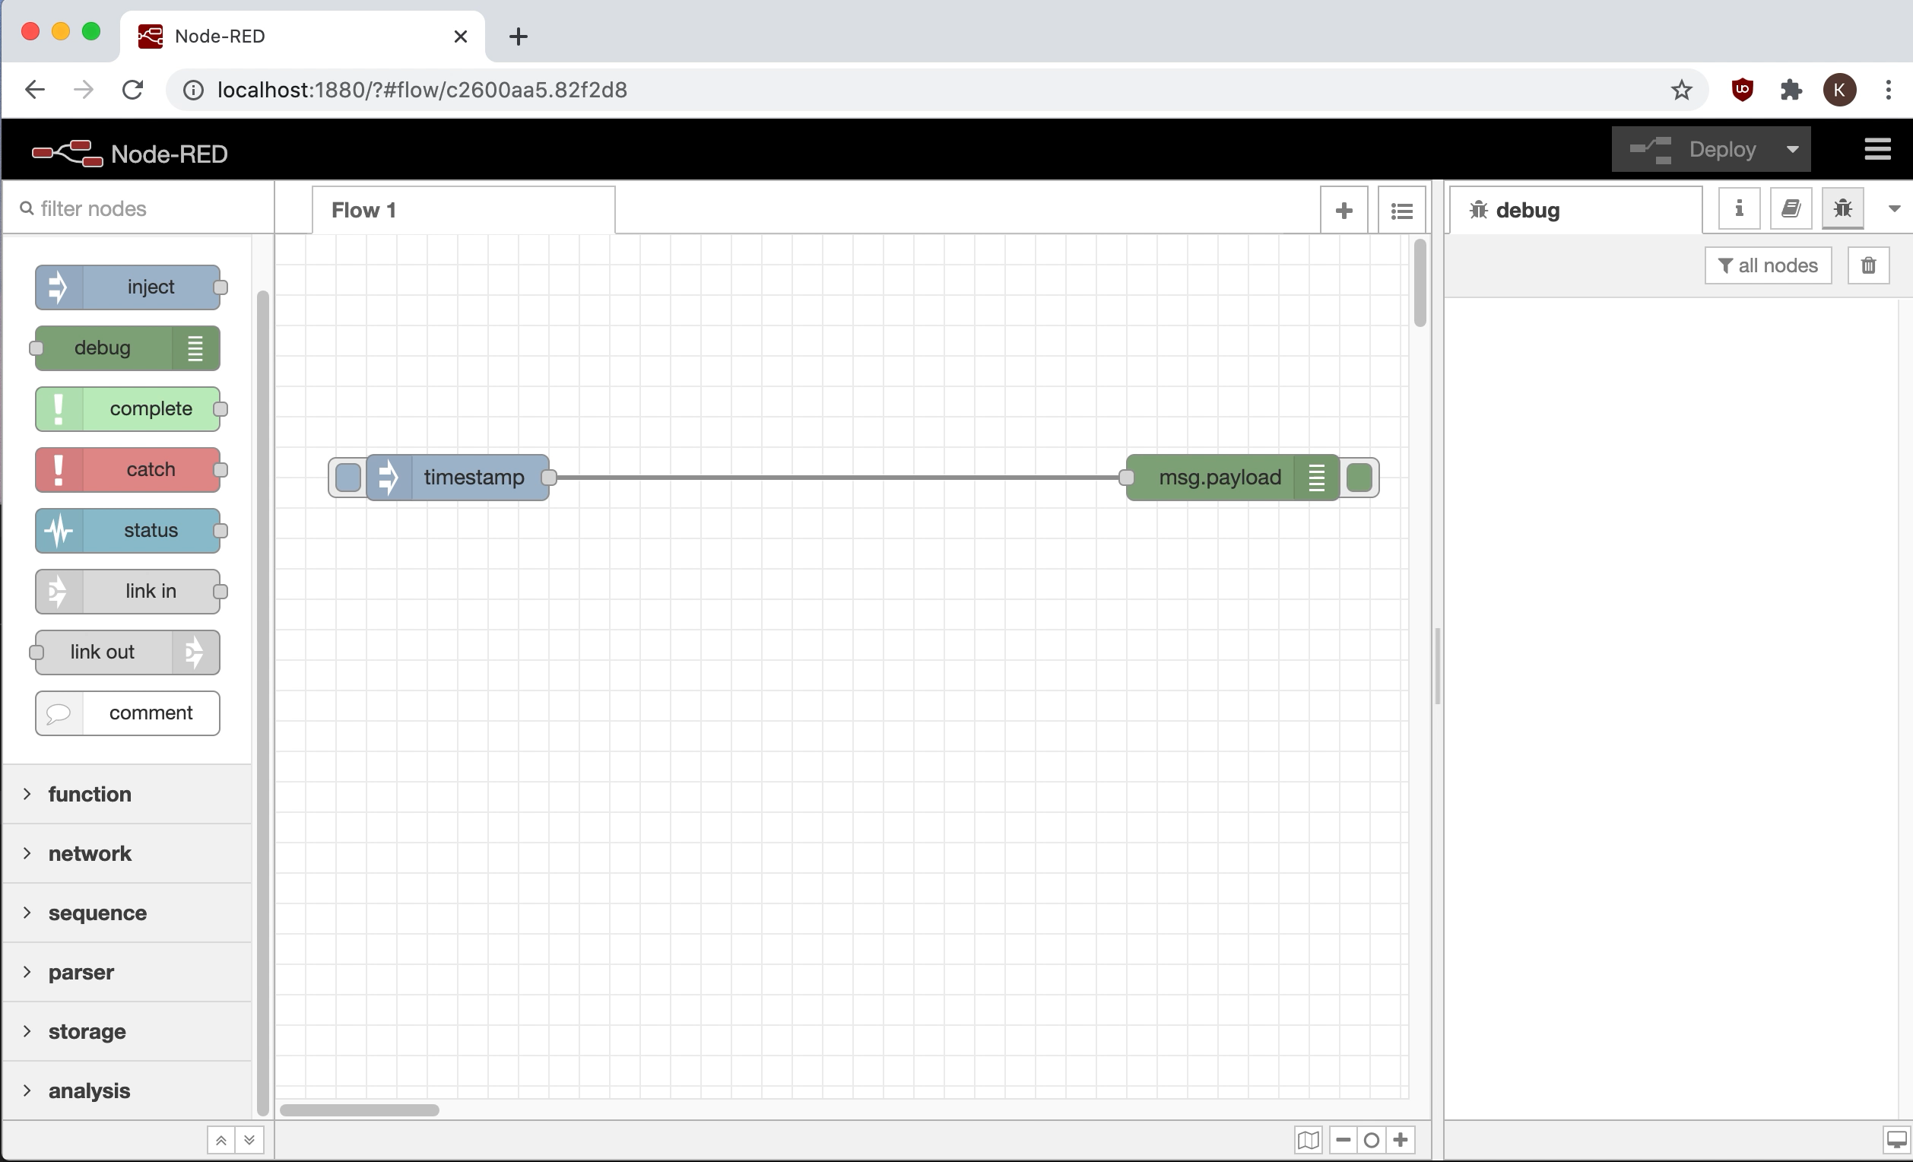

Slide 4


